Slide 1





ImageJ2 API-beating
Robert Haase
with material from Tobias Pietzsch, Florian Jug and Pavel Tomancak
Learnathon 2019
Adapted from NEUBIAS TS11

Slide 2
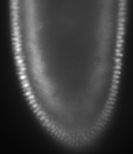


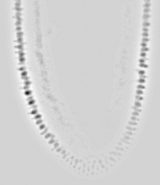
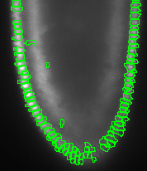

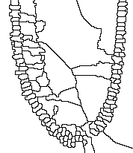
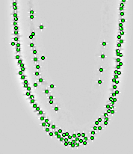
Fiji: Image analysis with feed on the ground
Low level image processing in all shades of grey
Subtract background
Gaussian blur
Division
Maxima detection
ROI manager / visualisation
Particle analysis / filtering
Seeded watershed

Slide 3
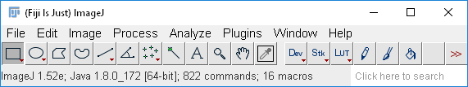
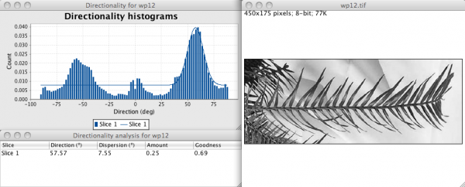
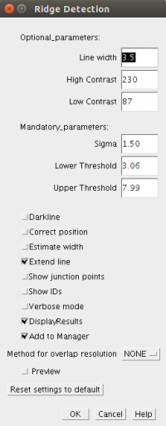
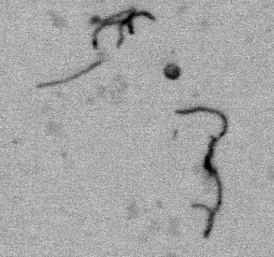
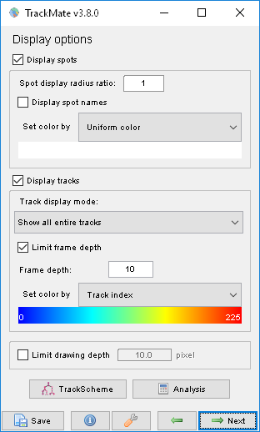
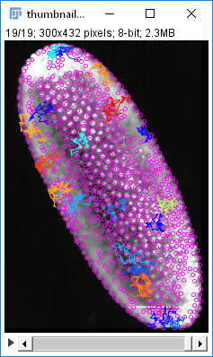
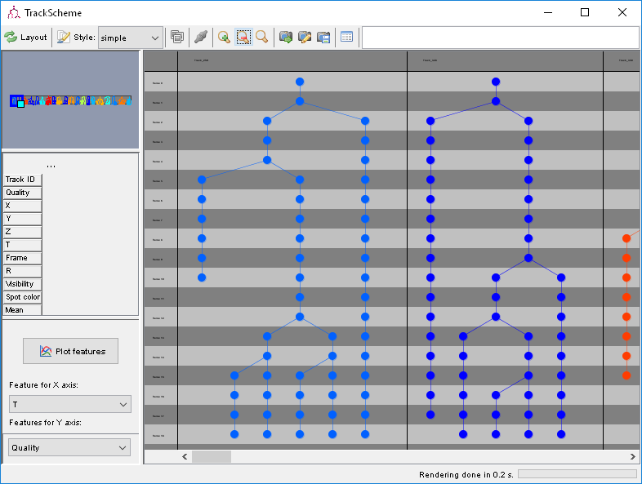
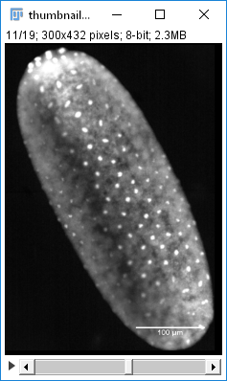
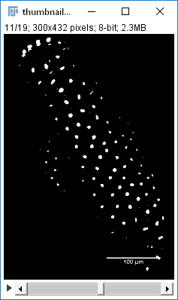
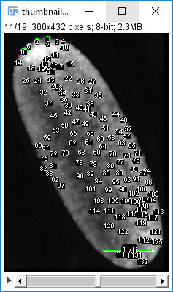
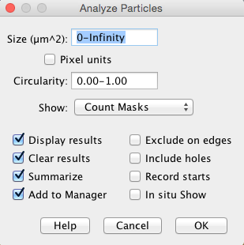
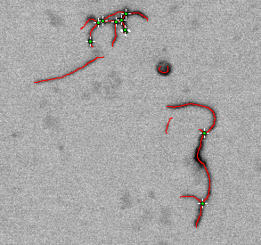
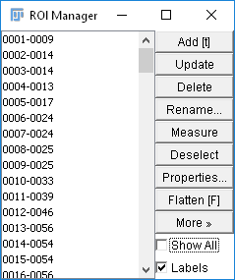
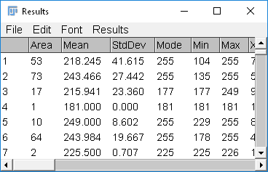
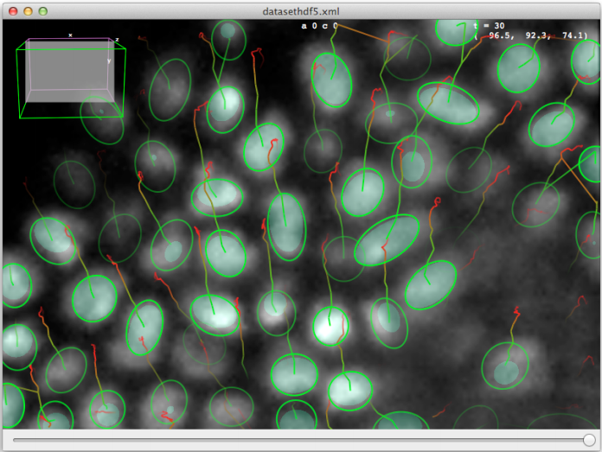
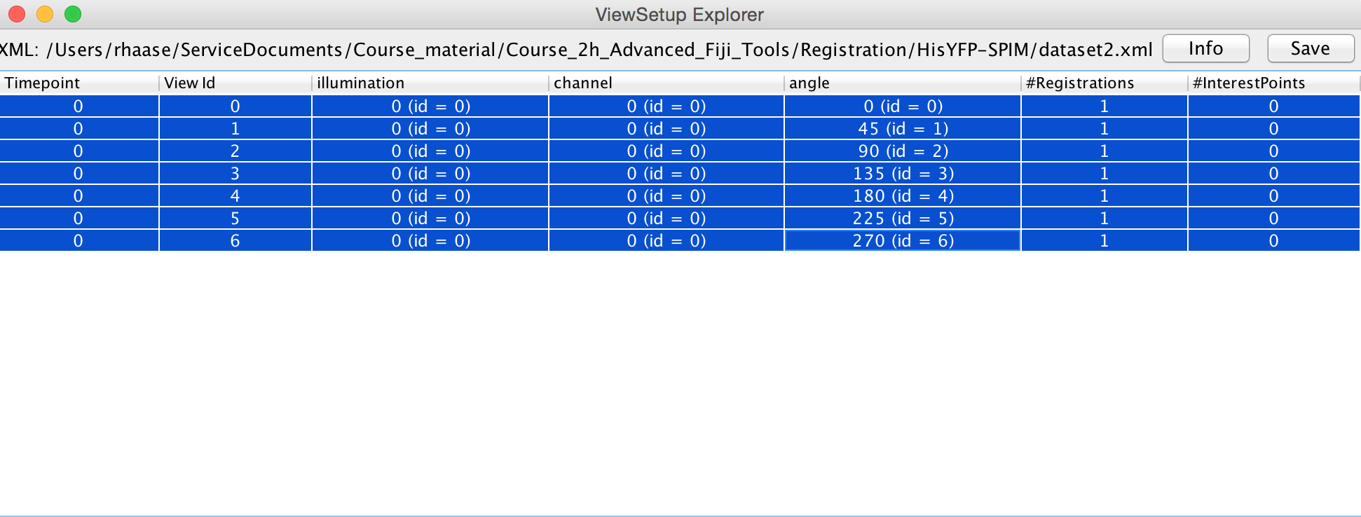
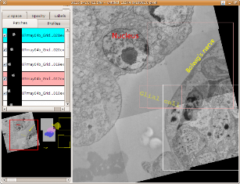
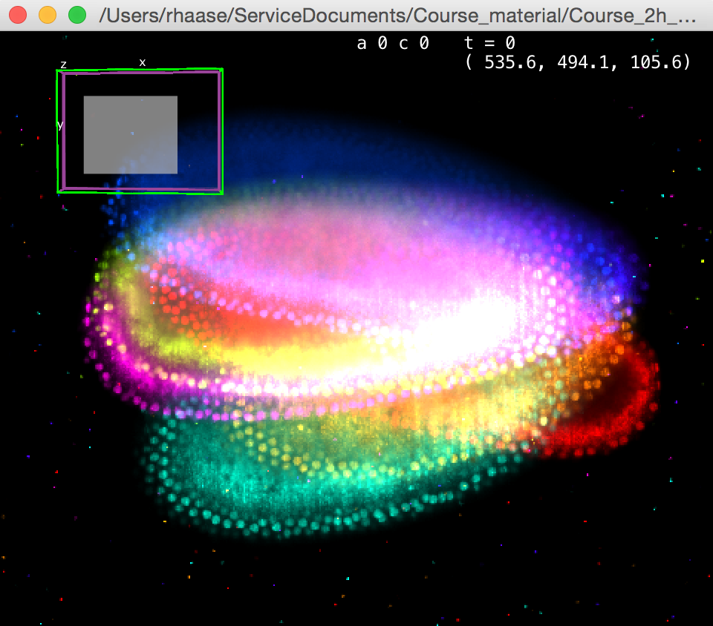
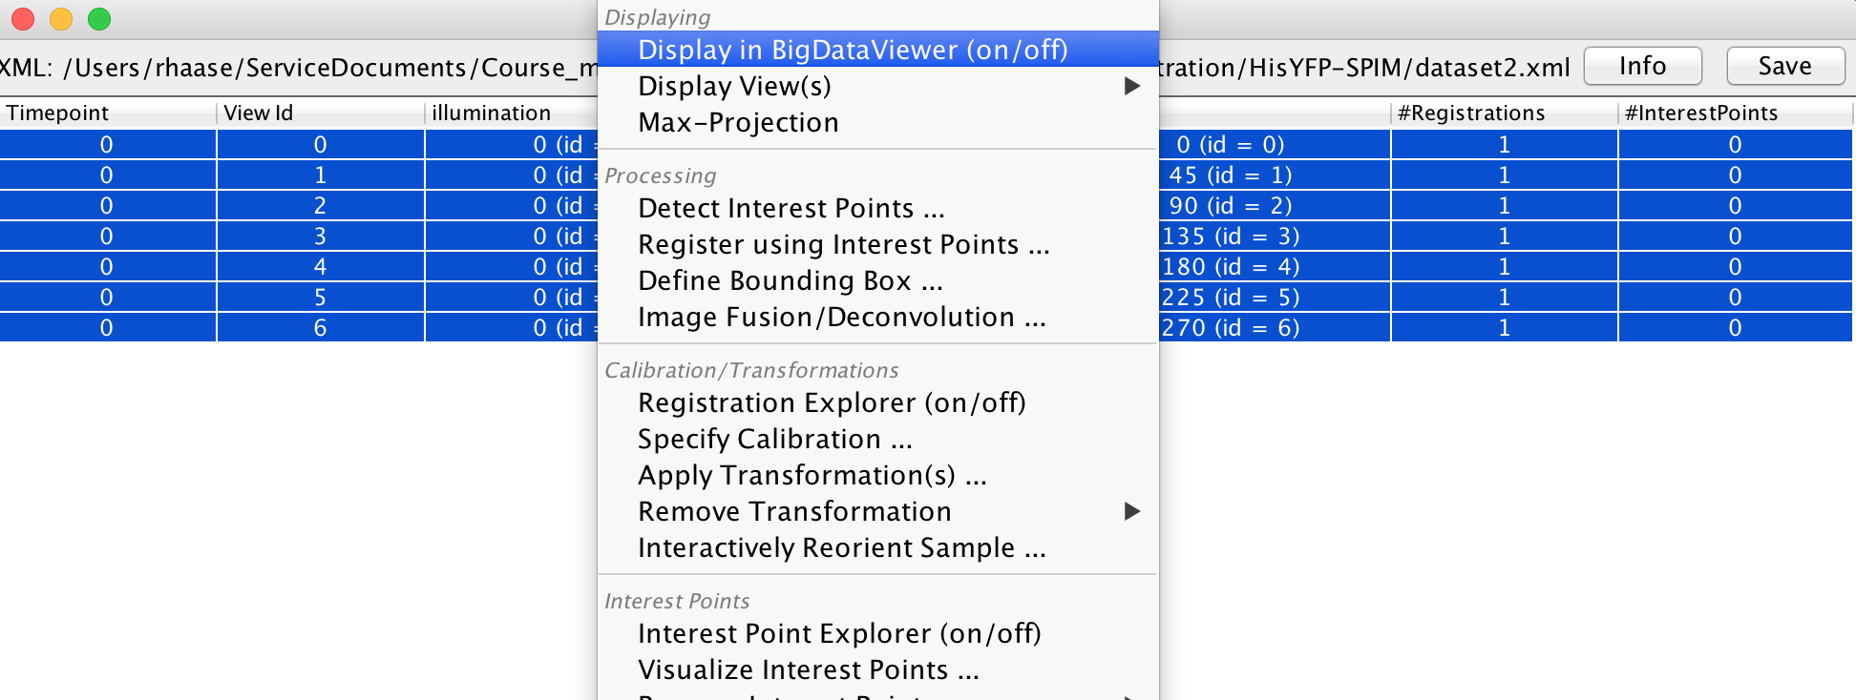
Fiji: Image analysis with the head in clouds
Fiji is just ImageJ + an endless list of sophisticated plugins for life scientists
Core ImageJ
Directionality
Ridge detection
Trackmate
BigDataViewer
Multiview fusion
TrakEM
And 800 more…
Image Source: Jaydeep Sidhaye, Norden Group, MPI CBG

Slide 4


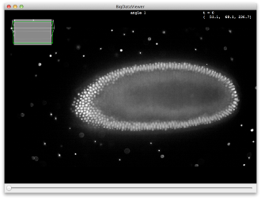
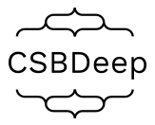
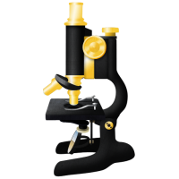


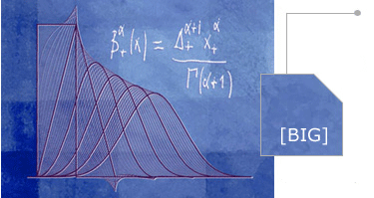

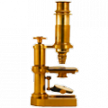

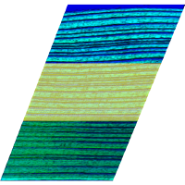




ImageJ & Fiji
ClearVolume
CSBDeep
BioFormats
BigDataViewer
Scenery / SciView
MaMut
ImageJ2
BIG-EPFL
CLIJ
ImageScience
TrakEM2
SCF-MPI-CBG
ImageJ
ImgLib2
BigDataTools
Trackmate
And sooo many more ….
BigDataViewer
SciJava
Fiji

Slide 5

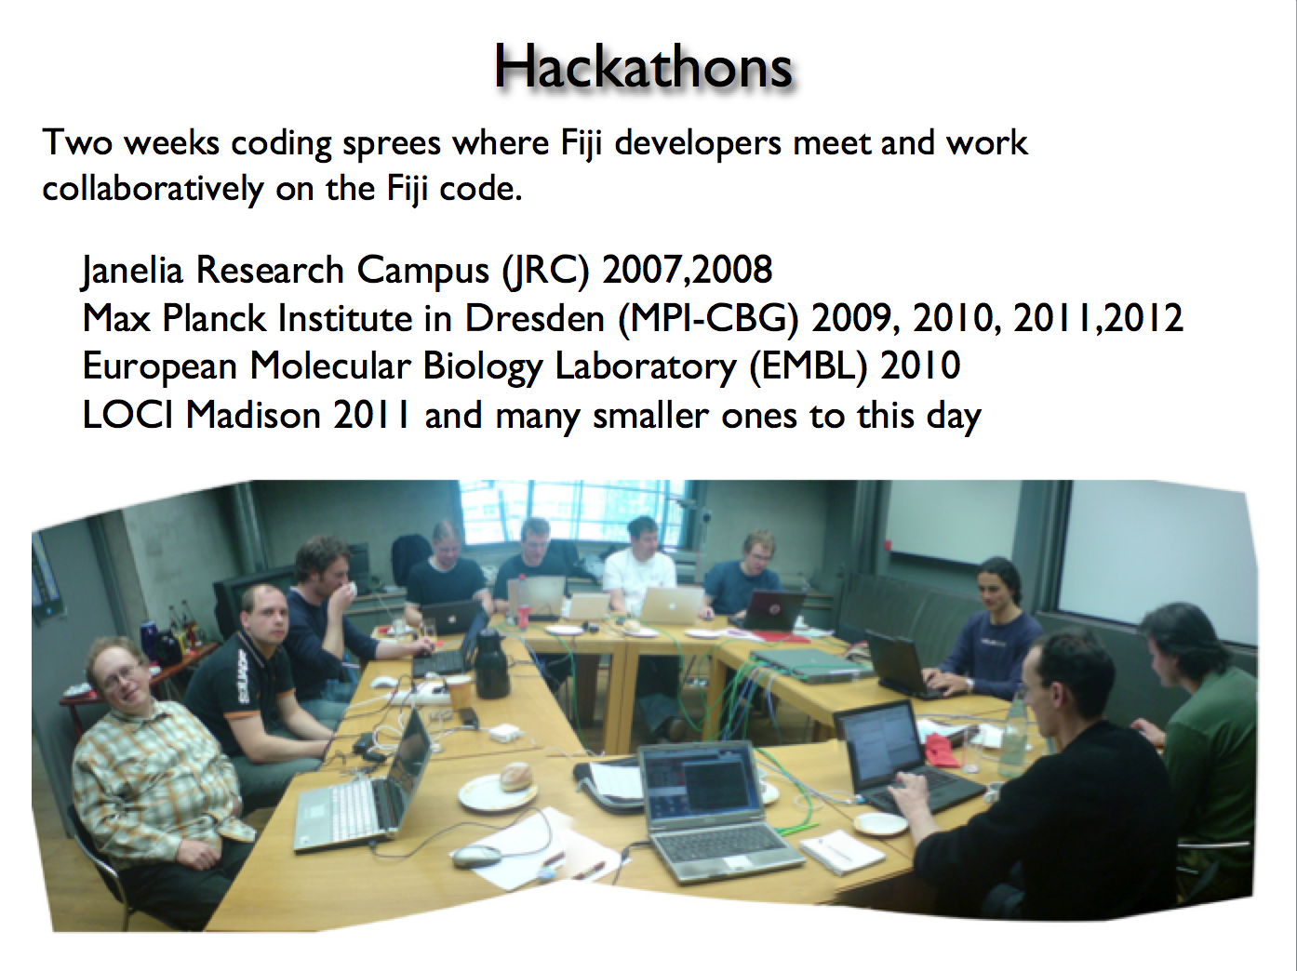
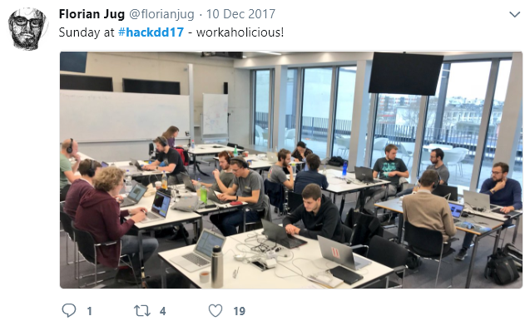
Fiji & friends development: hackathons & learnathons
Developer community meets (at least) annually
Hackathons: core developers meet with plugin developers to bring Fiji on the next level
Learnathons: core developers teach new/potential members of the developer community
Slide by courtesy of Pavel Tomancak, MPI-CBG

Slide 6
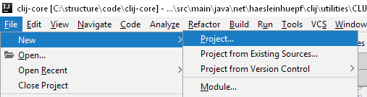
Setting up an ImageJ2 plugin
Using Integrated Development Environments (IDE) – today: IntellIJ
Nobody starts “New projects” in the ImageJ developers community.
We all have our own template which we carry with us, modify over time and duplicate to develop new plugins and workflows.
Let’s make a template for you.
Eclipse user? Watch: https://www.youtube.com/watch?v=YIWpoBnnLio

Slide 7
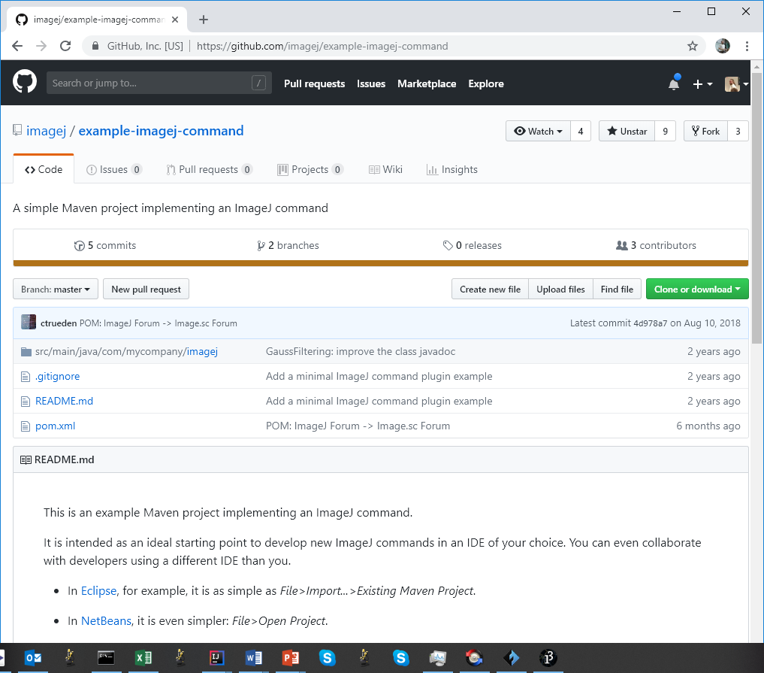
Exercise: Setting up an ImageJ2 workflow
Clone or download the code repository
git clone https://github.com/imagej/example-imagej-command

Slide 8
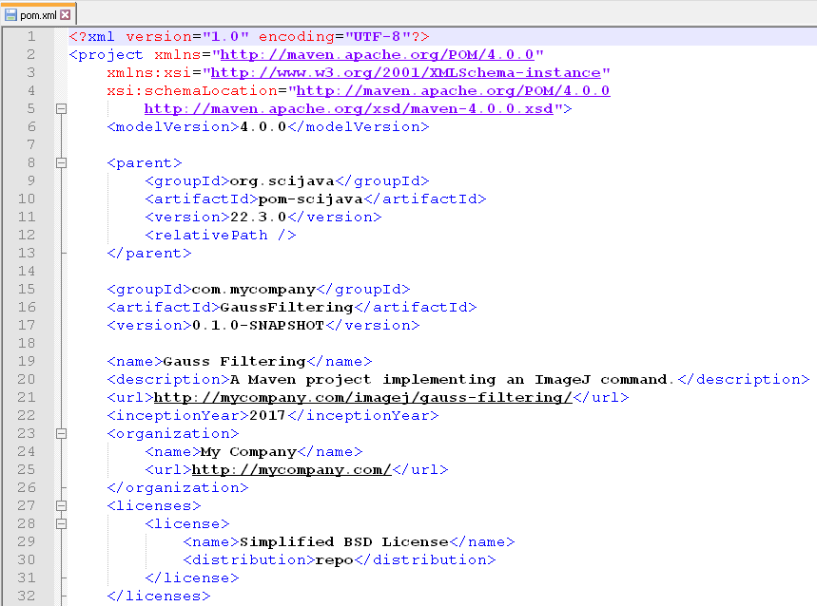
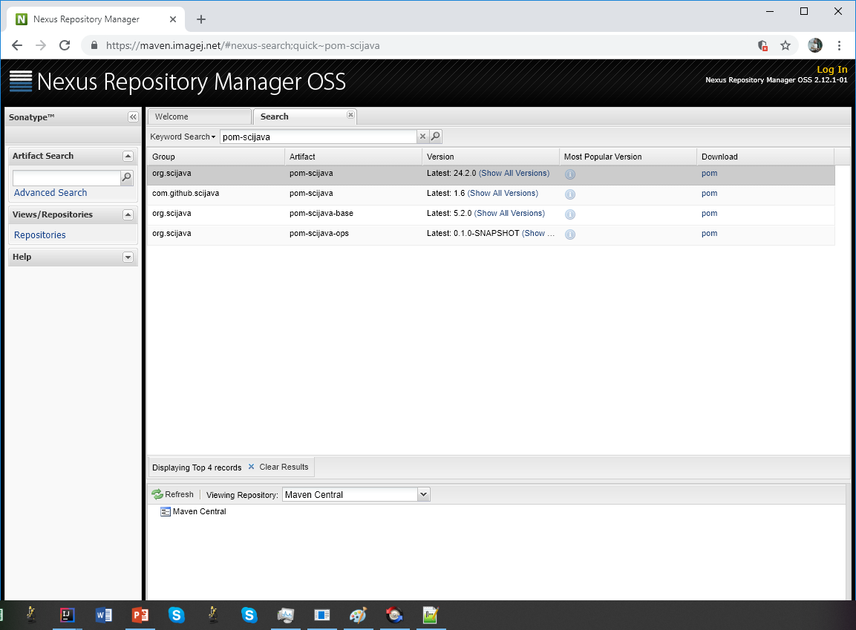
How to get started
To make maven work, every project needs a pom.xml file.
It contains information about the project and it relationship to ImageJ (dependencies)
You should make one pom.xml for yourself and then copy it to every other new project.
Step 1: Update the parent pom to make your plugin compatible to current ImageJ.
Open pom.xml in a text editor
Visit https://maven.imagej.net
Search for pom-scijava

Slide 9
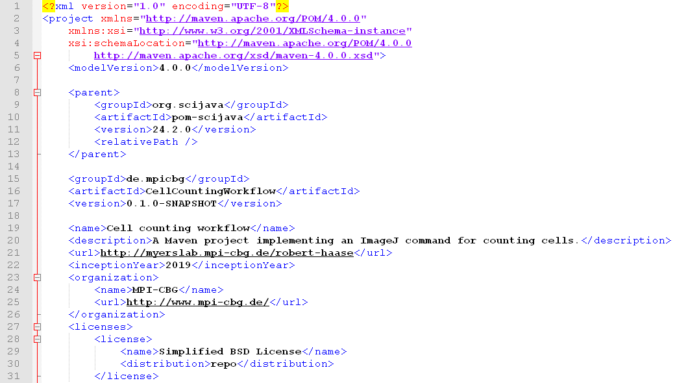
How to get started
Enter your information to the pom.xml file
No spaces or minuses allowed here
No spaces allowed here
Your domain
Your tool name
Description of your tool
Your website
Your institute website

Slide 10
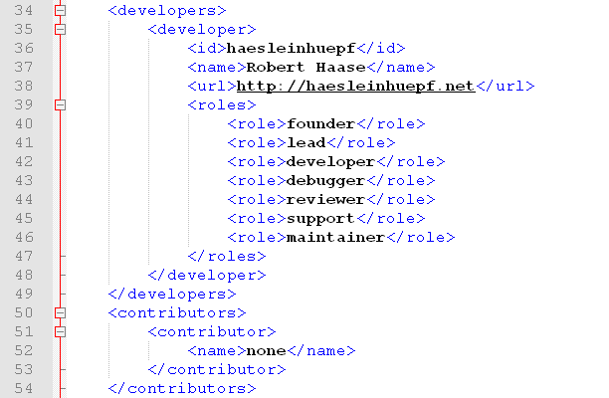
How to get started
Enter your information to the pom.xml file
You
Your role

Slide 11
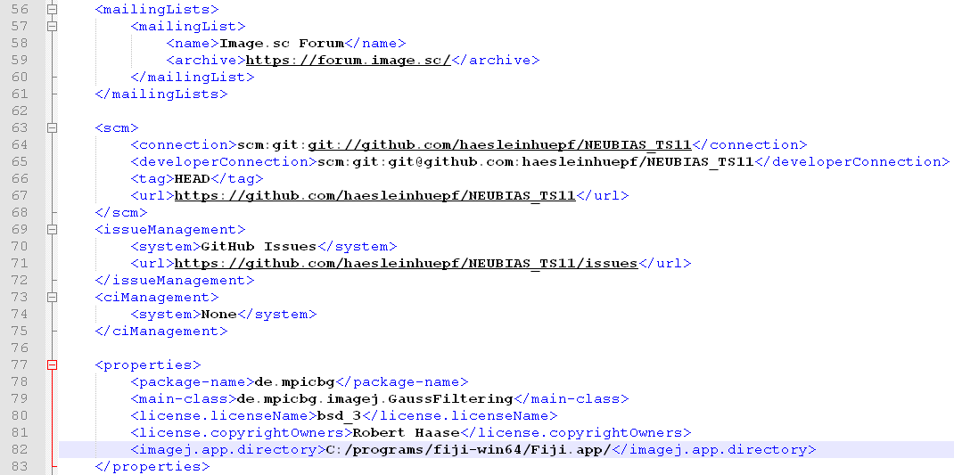
How to get started
Enter your information to the pom.xml file
Where is the code hosted?
Where is your Fiji installed?

Slide 12
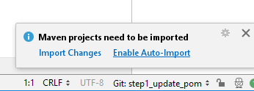
How to get started
Open the pom.xml file in IntelliJ
Go through the pom.xml to check if everything is right.
Save the pom.xml file (CTRL+S)

Slide 13
ImageJ ecosystem
ImageJ1
ImageJ-Ops
ImageJ2 / Imglib2
The Maven build system
ImageJ-legacy
ImageJ2
ImageJ
-ops
ImageJ1
imglib2
ImageJ-
legacy
My custom plugin
maven

Slide 14
ImageJ1
ImageJ1 architecture grew over the years
IJ
ImagePlus
ImageProcessor
Roi
AutoThresholder
ImageStatistics
At some point a group of developers decided to make ImageJ2 happen.

Slide 15
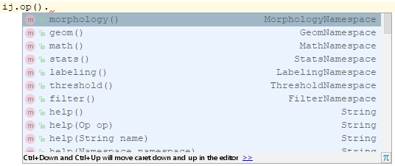
ImageJ-Ops
What is an operation?
ImageJ-Ops has nice answers to this question. Categorized.

Slide 16
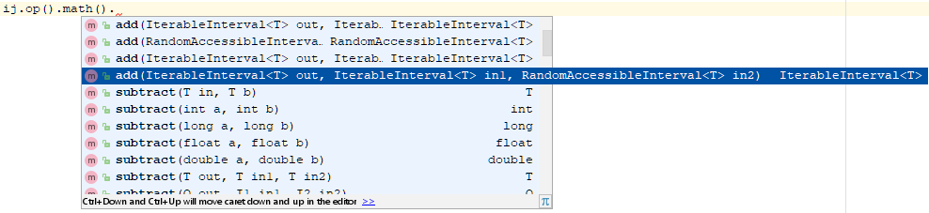
ImageJ-Ops
What is an operation?
Image calculator

Slide 17
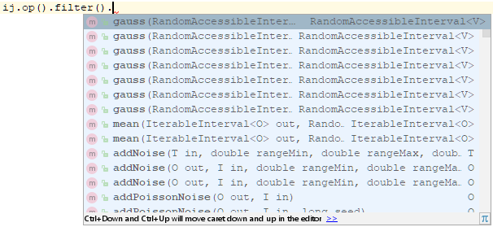
ImageJ-Ops
What is an operation?
Any kind of image filters

Slide 18
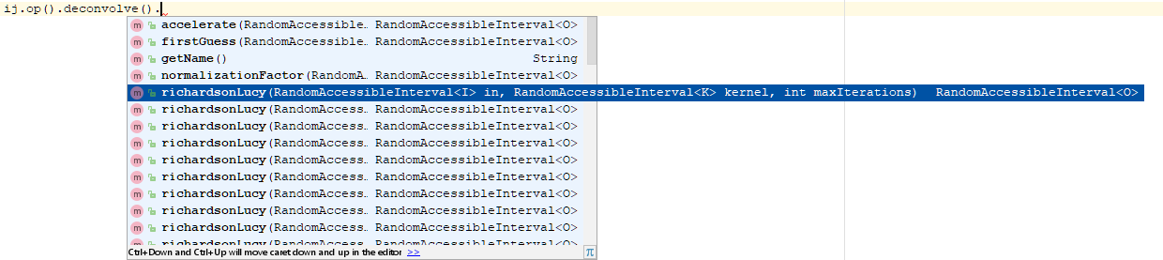
ImageJ-Ops
What is an operation?
Deconvolution!

Slide 19
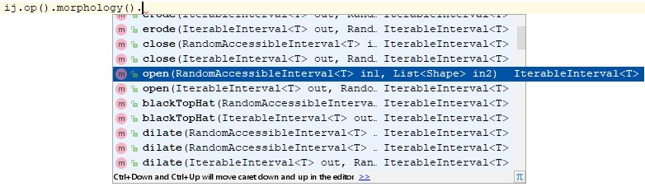
ImageJ-Ops
What is an operation?
Morphological filters

Slide 20
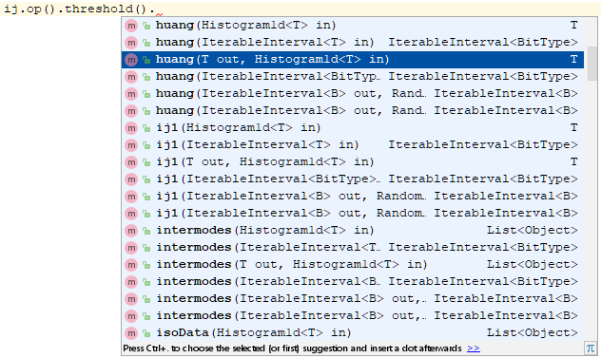
ImageJ-Ops
What is an operation?
ImageJ1 users find all threshold goodies in ImageJ-Ops

Slide 21
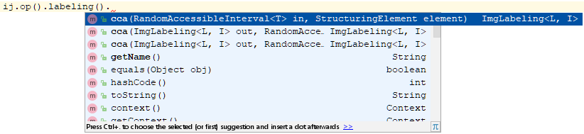
ImageJ-Ops
What is an operation?
Connected Components Analysis; a.k.a. the “Particle Analyser”

Slide 22
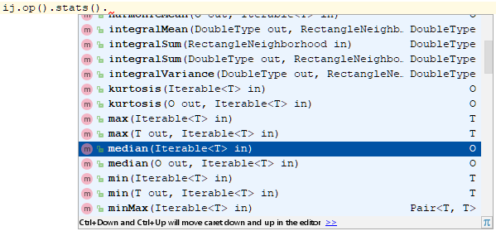
ImageJ-Ops
What is an operation?
Image -> Features

Slide 23
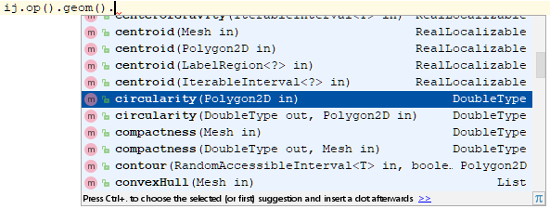
ImageJ-Ops
What is an operation?
Image -> Geometric object -> Features

Slide 24
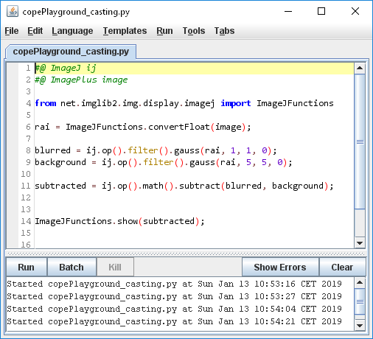

ImageJ2
The good news: It works from Fijis script editor in Python (Jython actually)
The bad news: To use it conveniently, you need different tools.

Slide 25
ImageJ2
What is an image?
An image is a set of pixels which can be randomly accessed.
An image is a set of pixels which can be iterated through.
An image is an n-dimensional interval of pixels, spatially or temporarily associated.

Slide 26
ImageJ2
What is an image?
An image is a set of pixels which can be randomly accessed.
An image is a set of pixels which can be iterated through.
An image is an n-dimensional interval of pixels, spatially or temporarily associated.
RandomAccessible
Iterable
Interval
RandomAccessibleInterval
IterableInterval
Img

Slide 27


ImageJ2
The class hierarchy in more detail
Read the supplement of this paper!
ImgLib2—generic image processing in Java. Tobias Pietzsch, Stephan Preibisch, Pavel Tomančák, and Stephan Saalfeld. Bioinformatics. 2012 Nov 15; 28(22): 3009–3011

Slide 28


ImageJ2
Create images and wrangle types
Every Img is a RandomAccessibleInterval. But not every RandomAccessibleInterval is an Img!

Slide 29



ImageJ2
Casting
ALT+ENTER
ENTER

Slide 30

ImageJ2
Types
Parameter type
Parameter type
Return type

Slide 31


ImageJ2
Converting
CTR+P

Slide 32


ImageJ2
Converting

Slide 33

ImageJ2
Wrapping

Slide 34
Useful links
https://imagej.net/ImgLib2
http://forum.imagej.net/tags/c/development/imglib
https://github.com/imglib/imglib2-tutorials
https://github.com/imglib/imglib2-introductory-workshop
https://github.com/imglib/imglib2-advanced-workshop
https://github.com/imglib/imglib2-cache-examples

Slide 35
ImageJ ecosystem
ImageJ1
ImageJ-Ops
ImageJ2
The Maven build system
ImageJ-legacy

Slide 36


The maven build system
ImageJ projects are organized with maven.
https://maven.apache.org/
The pom.xml file we just created is a Maven project file.
The most important maven commands are
package: make a jar-file ready for ImageJ
install to ImageJ folder
deploy to an online
repository
test: execute unit tests

Slide 37


Renaming packages
Rename the main package by entering your organisations url. Minuses – are not allowed.

Slide 38

Rename classes
Open the GaussFiltering class and rename it

Slide 39

Getting started
Empty the class to get an empty work space

Slide 40


Getting started
Enter a hello world message and run the program!
Welcome to ImageJ2!

Slide 41






ImageJ legacy
Add a dependency to imagej-legacy and run your program again!

Slide 42

Before continuing
Copy this project now!
This is the starting point for your future ImageJ projects!
The things we do next, are also available on github – as branches
https://github.com/haesleinhuepf/
daisLEARNATHON2019

Slide 43
10 Minutes break. Then we get our hands dirty!

Slide 44

GPU-accelerated Image Processing in Fiji
Robert Haase, Myers lab
dais learnathon Dresden

Slide 45



GPU-accelerated image processing
… has benefits
https://clij.github.io/clij-benchmarking/benchmarking_operations

Slide 46
CLIJ from Java
CLIJ comes via an independent maven repository.
<dependency>
<groupId>net.haesleinhuepf</groupId>
<artifactId>clij-core</artifactId>
<version>1.0.4</version>
</dependency>
<repository>
<id>clij</id>
<url>http://dl.bintray.com/haesleinhuepf/clij</url>
</repository>
https://clij.github.io/clij-docs/dependingViaMaven

Slide 47

CLIJ from Java
The clij Java API is very similar to the macro API
// init CLIJ clij = CLIJ.getInstance(); // send image to GPU memory and reserve memory for output ClearCLBuffer input = clij.push(imp); ClearCLBuffer output = clij.create(input); // Gaussian blur
float sigma = 3;
clij.op().blur(input, output, sigma, sigma); // get result back from GPU ImagePlus result = clij.pull(output); result.show();
// cleanup memory
input.close();
output.close();
https://clij.github.io/clij-docs/referenceJava
https://clij.github.io/clij-docs/api_intro

Slide 48

The clij gateway
Keep your clij variable. It gives you access to everything.

Slide 49

The clij gateway
Keep your clij variable. It gives you access to everything.

Slide 50



Summary
If you prefer ImageJs python programming, consider having IDE and Fiji open in parallel.

Slide 51


Summary
The power of ImageJ2 is a bit hidden
Use auto-completion of your IDE to discover it!
Press CTRL+P to find out parameters of a method
Improve the general discoverability by giving things good names. Use SHIFT+F6 to rename methods, classes,…
If there are issues
Use ALT+Enter to resolve them
Choose your IDE wisely and stick to it
They are all good. But you need to learn how to use them.
Choose your favorite programming language.
Don’t fight the fight Java versus Python. Consider becoming language agnostic.
Learn one properly. Learn a second. Do whatever fit’s best in your environment and stick to it.
Become expert and never stop learning.

